Slide 1

WQD 7003 Data Analytics
CHAPTER 7 – MACHINE LEARNING
Saw Shier Nee, Hema Subramaniam & Aznul Qalid Md Sabri
sawsn@um.edu.my , hema@um.edu.my, aznulqalid@um.edu.my
Dept. of AI, Fac. of Computer Science and IT, University of Malaya
Dept. of SE, Fac. of Computer Science and IT, Universiti Malaya

Slide 2

Outline
Build machine learning models using SAS

Slide 3
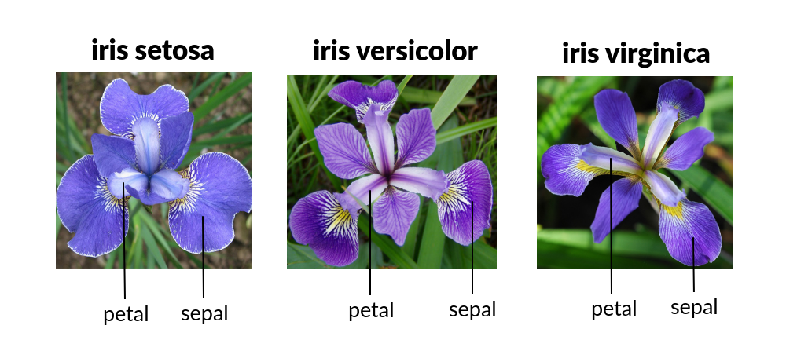
Develop Decision Tree to classify type of flower
Input
Petal Length
Petal Width
Sepal Length
Sepal Width
Output
Setosa
Versicolor
Virginica
Machine Learning Model

Slide 4
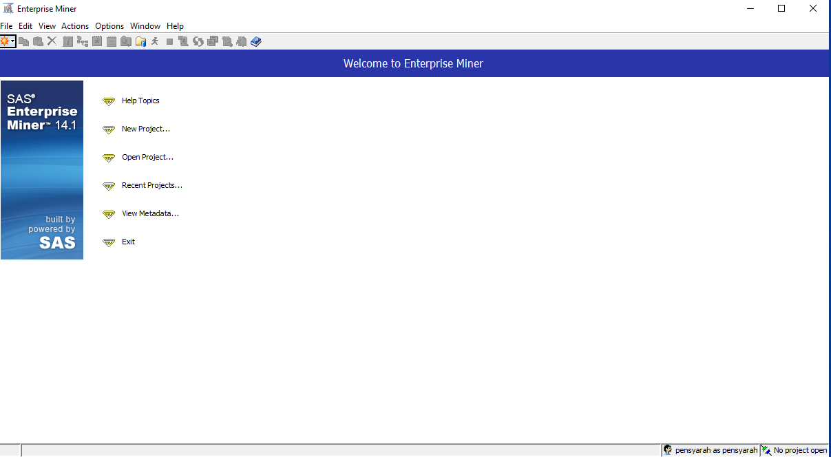
Open SAS Miner in the desktop

Slide 5
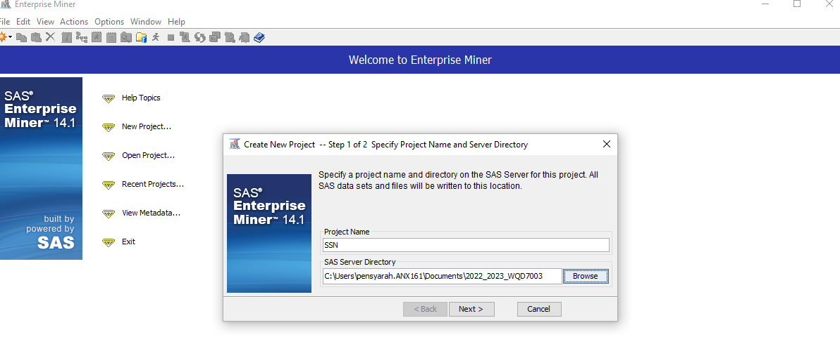
File > New > Project
Insert Project Name and choose a directory to store all your data
Click Next > Finish

Slide 6
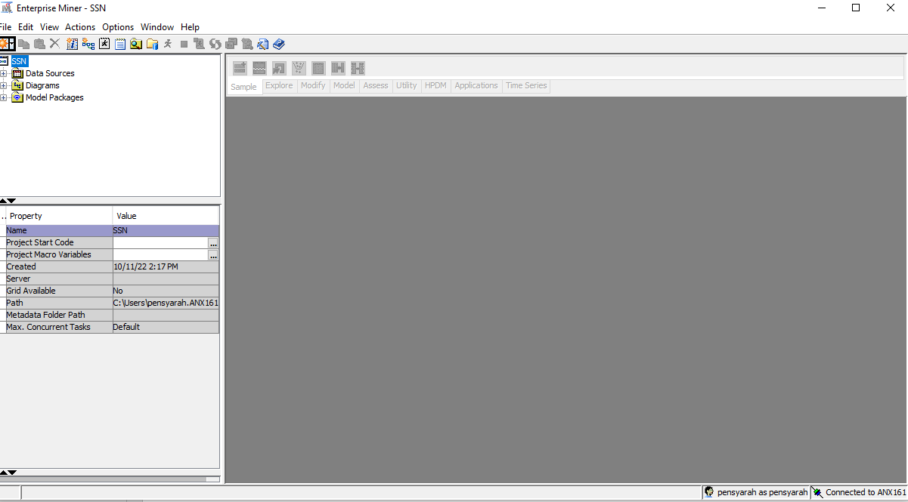
You will see this window

Slide 7
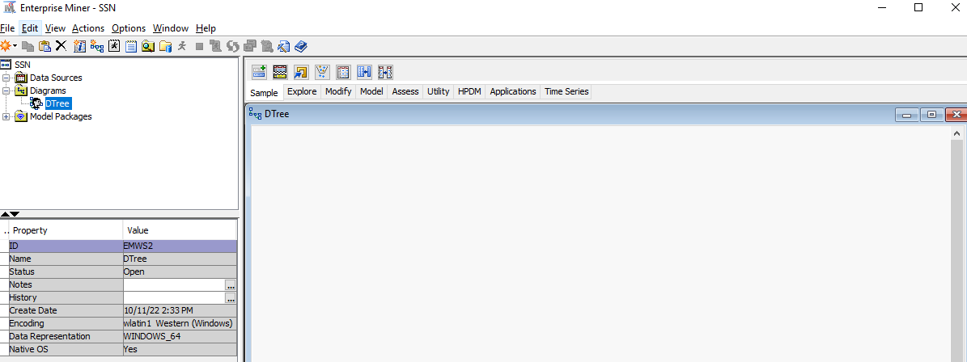
Now, we want to create Decision Tree
Diagram > Create Diagram > DTree

Slide 8
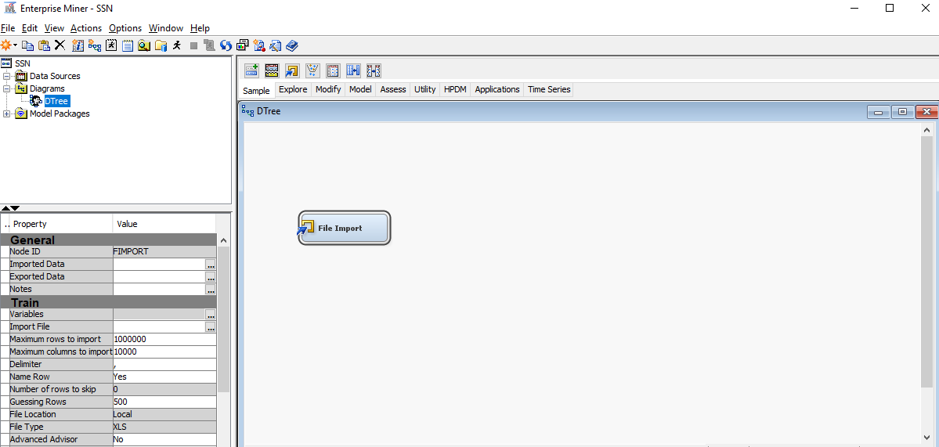
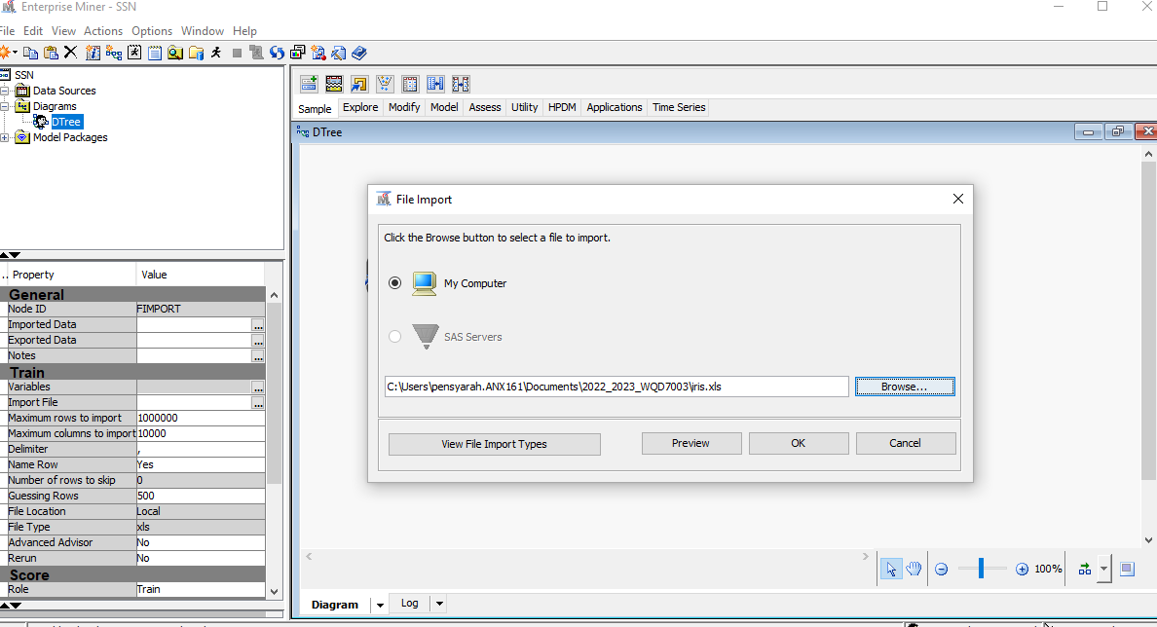
Drag Import File to working space
1
Click Import File
Select Iris.xlsx that can be downloaded from spectrum
Click OK
2
3
4

Slide 9
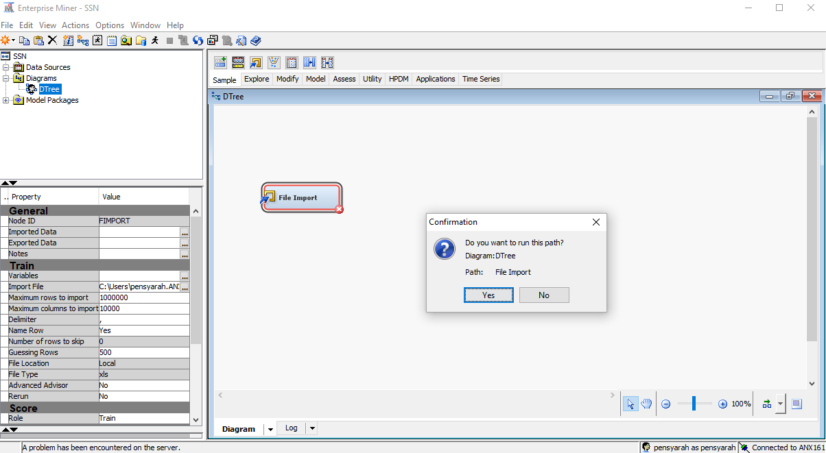
Right click on File Import > Run > Yes

Slide 10
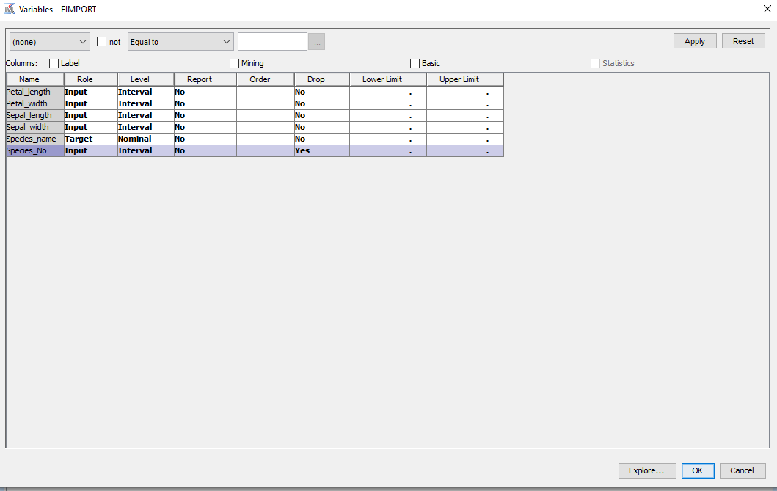
Right click on File Import > Edit Variable
We use petal length, petal width, sepal length and sepal width as input to predict the flower class.
Drop: Species_No
Input:
Petal Length
Petal Width
Sepal Length
Sepal Width
Target:
Species Name
Click Ok
1
2
3

Slide 11
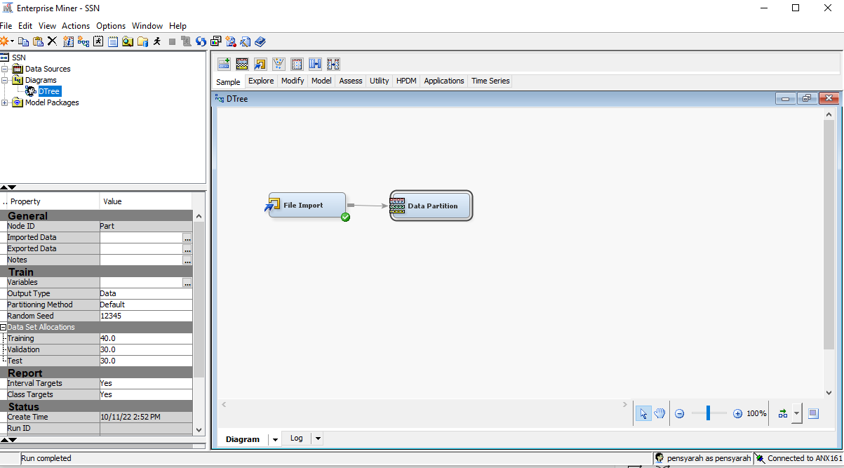
Drag Data Partition to working space
Connect File Import to Data Partition in the working space. You should see a arrow connecting between two cells.
1
2

Slide 12
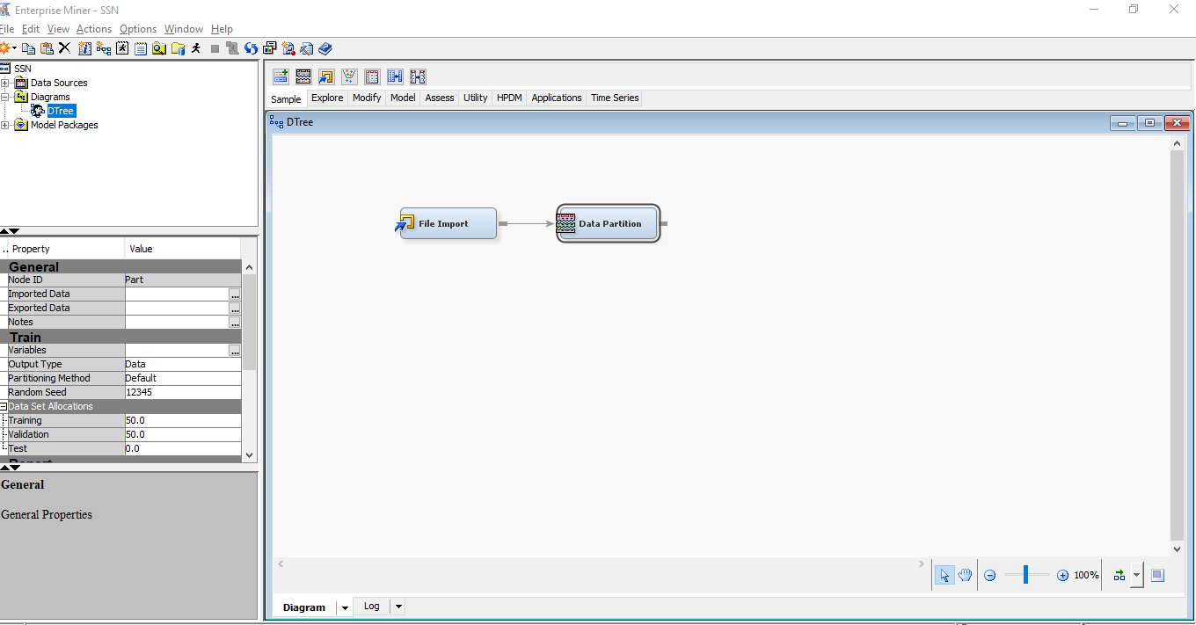
You can change splitting ratio here. We use 50% training, 50% validation.
Right click on Data Partition > Run > Yes
2
1

Slide 13
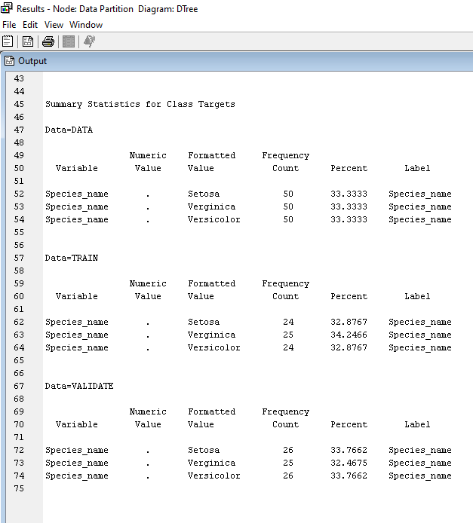
To view data distribution, right click on Data Partition > Results
Three class type:
Setosa – 50
Verginica – 50
Versicolor – 50

Slide 14
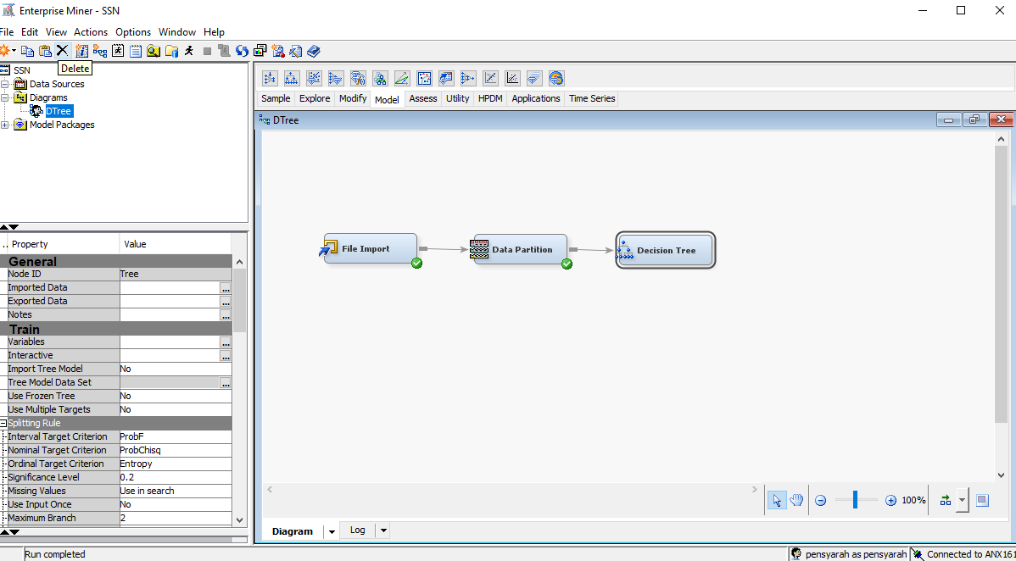
Now, we create Decision Tree. Model > Decision Tree
Drag Decision Tree to workspace.
Connect Data Partition to Decision Tree in the working space. You should see a arrow connecting between two cells.
2
1
3

Slide 15
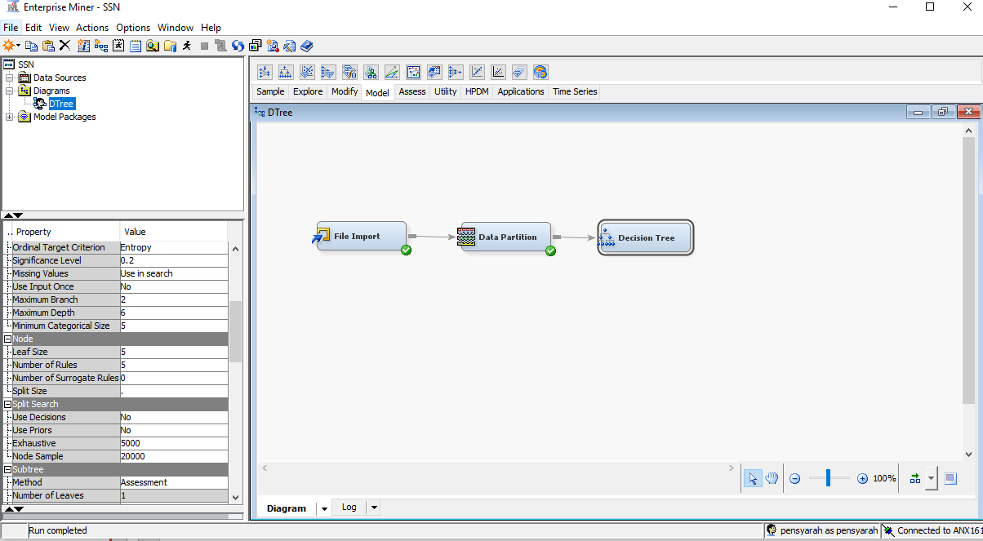
You can change parameter here such as maximum branch, depth, leaf size. We will use default values.
Now, we train the model. Right click on Decision Tree> Run > Yes

Slide 16
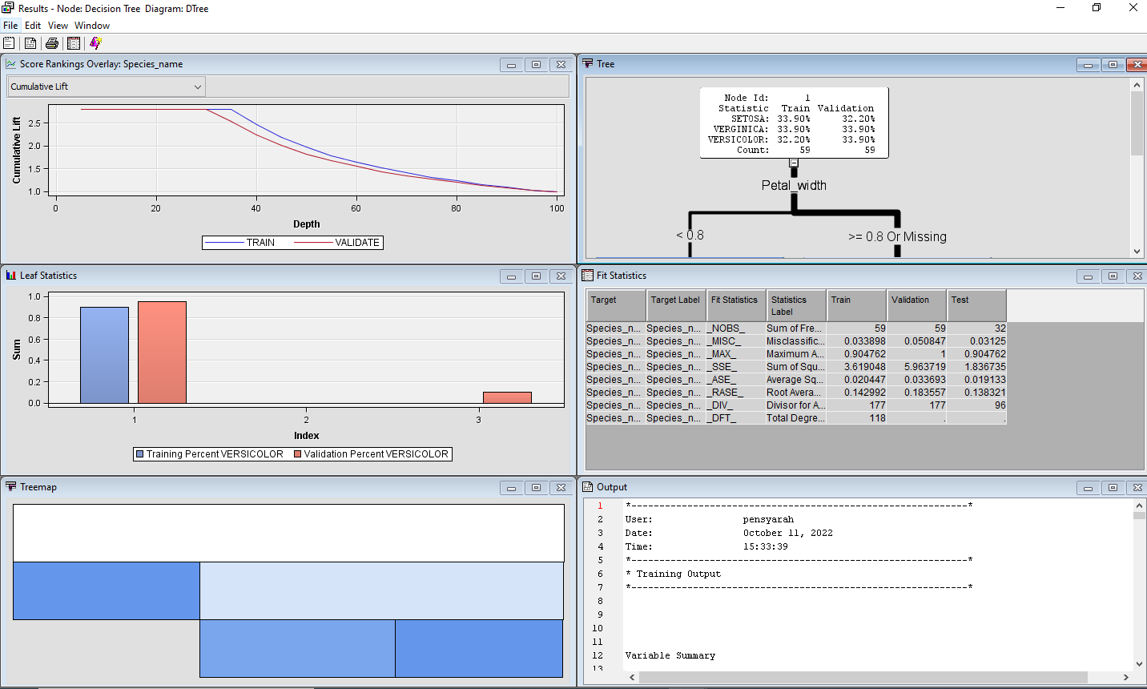
To view results. Right click on Decision Tree> Results
To view the decision tree rule

Slide 17
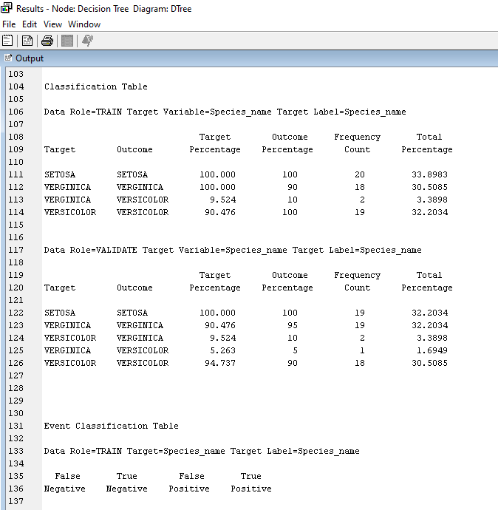
To view the classification report.
Tabulate it to confusion matrix
Train
 |  | Target
 |  | Setosa | Verginica | Versicolor
Outcome | Setosa | 20 | 0 | 0
 | Verginica | 0 | 18 | 0
 | Versicolor | 0 | 2 | 19
Validate
 |  | Target
 |  | Setosa | Verginica | Versicolor
Outcome | Setosa | 19 | 0 | 0
 | Verginica | 0 | 19 | 2
 | Versicolor | 0 | 1 | 18

Slide 18
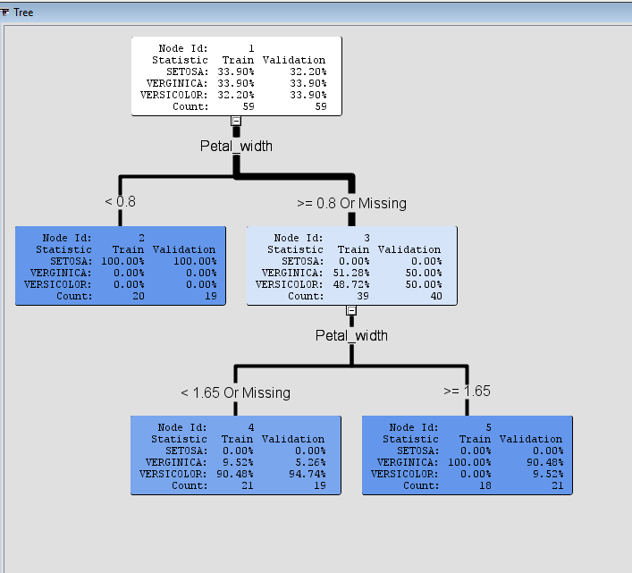
To view the decision tree rule

Slide 19
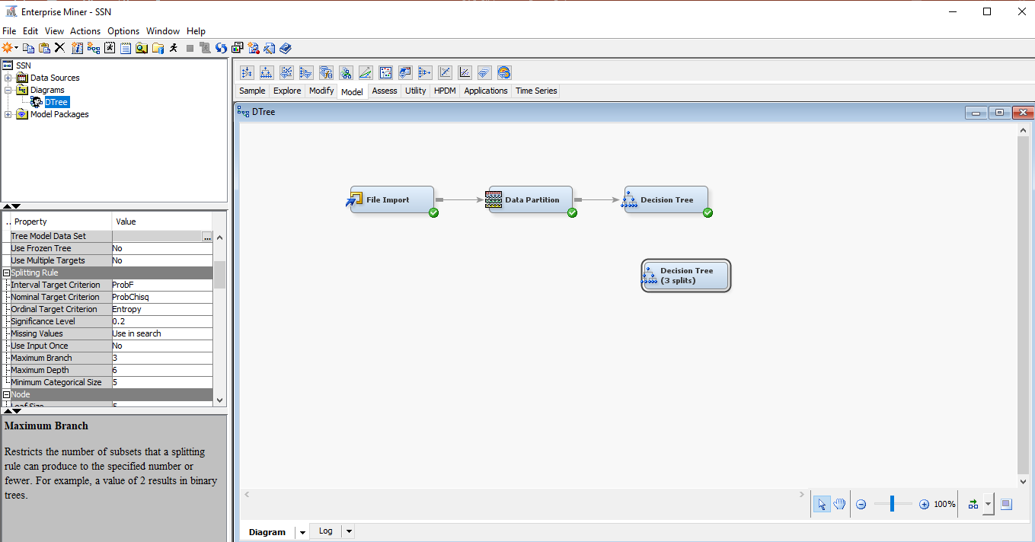
Now, create another decision tree model and change the max branch to 3.
Now, we train the model. Right click on Decision Tree> Run > Yes. Check results.

Slide 20
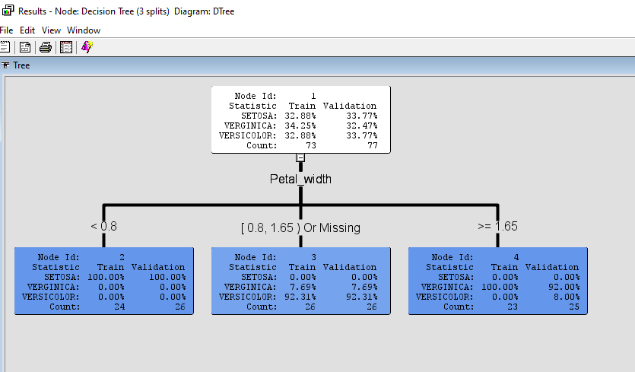
You can see that now you only have one depth and 3 branches.

Slide 21
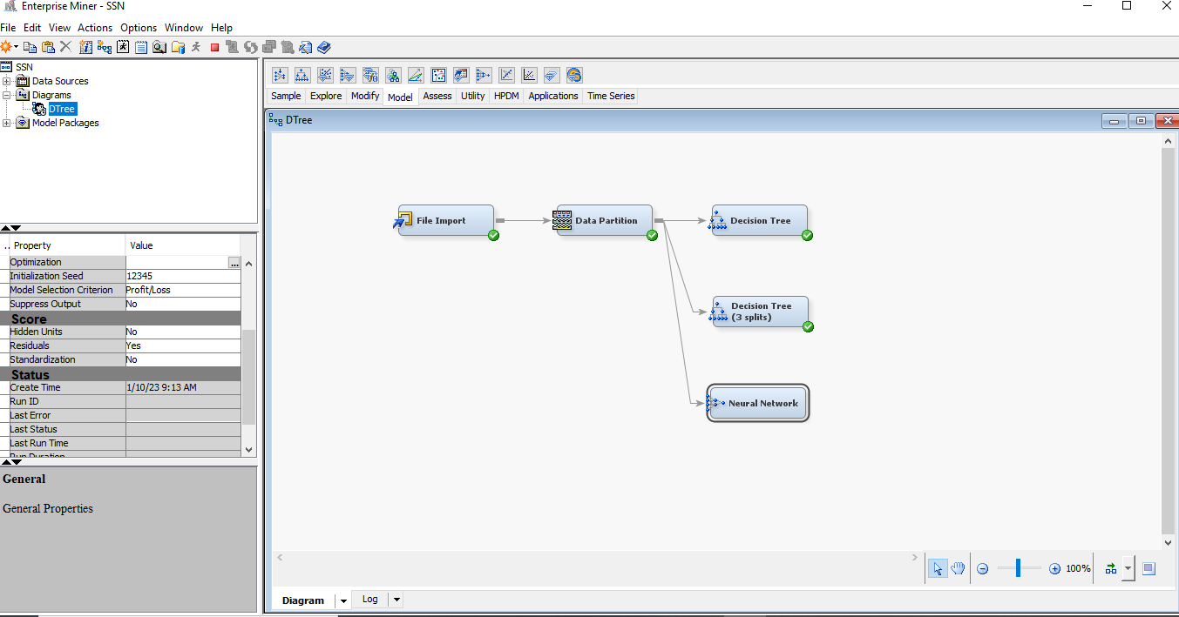
Build a neural network model. Drag neural network to workspace.
Connect Data Partition to neural network in the working space. You should see a arrow connecting between two cells.
Now, we train the model. Right click on neural network > Run > Yes

Slide 22
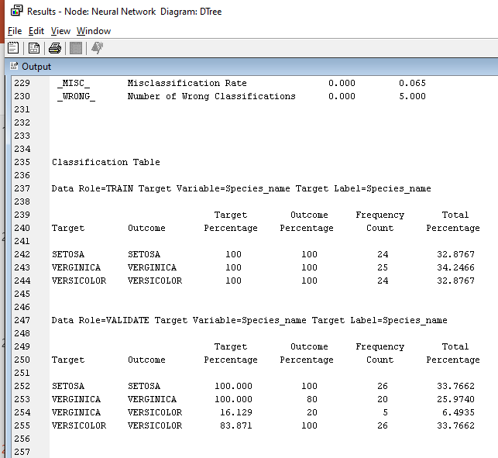
To view the classification report.
Tabulate it to confusion matrix (Student to fill in the blank)
Train
 |  | Target
 |  | Setosa | Verginica | Versicolor
Outcome | Setosa
 | Verginica
 | Versicolor
Validate
 |  | Target
 |  | Setosa | Verginica | Versicolor
Outcome | Setosa
 | Verginica
 | Versicolor

Slide 23
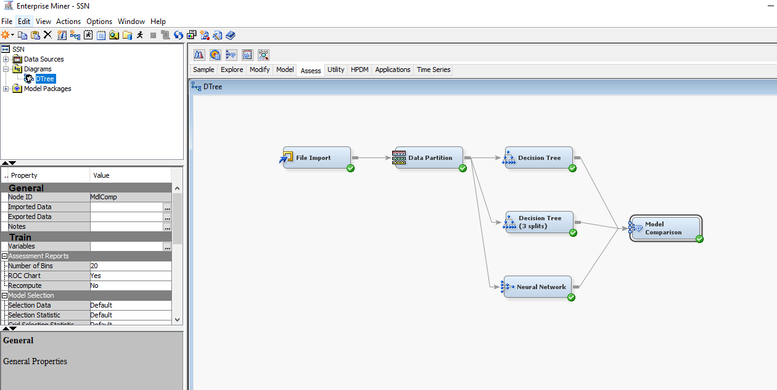
Compare the model. Click “Assess” Tab > Drag “Model Comparison” to workspace
2
1

Slide 24
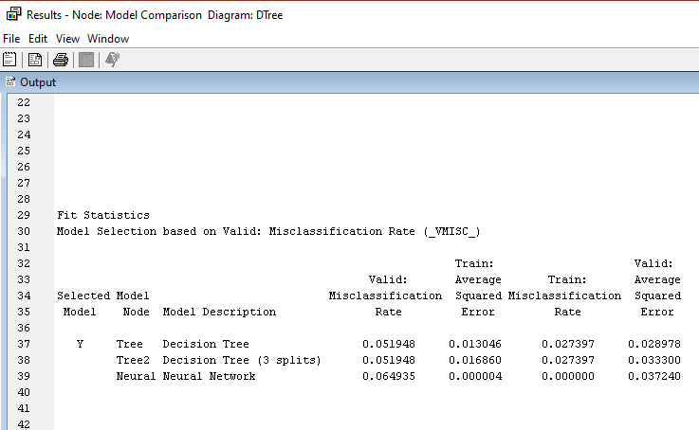
Decision Tree with different configurations have similar performance
Although Neural Network has low misclassification rate on training data than Decision Tree, it has higher misclassification rate than Decision Tree in validation
Indicating overfitting

Slide 25
Reference
https://www.youtube.com/watch?v=IVHdZwf1nlw&list=PL2drDZxALauC4u_Hvb-pk3OdWMiXS_Mbg
https://documentation.sas.com/doc/en/emref/15.2/bookinfo.htm

